Slide 1
AUTHBOOK
Multi-factor transaction
Authentication based on QR code
Notes:
[Start of Presentation]
Welcome, everyone. Today, I'm thrilled to introduce you to AuthBook, our cutting-edge room booking and management platform. :P

Slide 2
Group Members
Matthew Chin Yu Kang: 7768990
Randall Lim Shi Hao: 8107002
Teo Wei Zhi Zakary: 7769258
Mahina Lim Fong Jia: 8378885
Ryzlan Afiq Bin Roslan: 7895124

Slide 3
TABLE OF CONTENTS
01
02
03
04
05
Challenges
Competitors
Our Solution
Demo
Business Plan
Notes:
Introduction (ryzlan)
The Challenges(randall)
Competitor (zakary)
Our solution (Zakary)
Demo (ryzlan)
Business plan (ryzlan)

Slide 4

01
Current Challenges
Conflicting reservations and double booking
Room hogging resulting in space inefficiency
Lack of updated room availability information at a single pane
Notes:
To kick things off, we’ll first be discussing the challenges that all too often plague current room booking systems. (change from point to numbering)
Conflicting reservations and double booking. This occurs when more than one unrelated reservation is scheduled simultaneously for the same location. Such conflicts lead to delays, confusion and inefficiency.
On the topic of inefficiency, room hogging resulting in space inefficiency. As a consequence of having reservations that are separate from each other occupying the same room, this takes up a lot of space that could have been used for 1.
To top it all off, these challenges are compounded by lack of updated room availability info at single plane. Such information will have to be viewed through more than one panel, rendering the entire process inconvenient and sub-optimal.
PASS MIC TO ZAK NEXT

Slide 5






02
Current Solutions in the market
Problem | Robin | Skedda | Envoy | SpaceIQ
Conflicting Reservations / Double Booking
Room Hogging / Inefficient Space Utilization
Lack of Updated Room Availability
Notes:
Skedda & Robin ===========================================
Customization: Skedda offers customizable booking options for different types of spaces like meeting rooms, event spaces, and classrooms. It allows users to adjust settings based on their specific needs, which is great for companies with diverse room types. Robin Space Optimization: Robin’s powerful space management features allow businesses to optimize room usage based on availability and demand, helping improve efficiency.
Envoy User-friendly Interface: Envoy provides an easy-to-navigate interface that makes room booking simple for employees, along with automatic check-in for users when they arrive at the offic
Comprehensive Analytics: SpaceIQ provides excellent analytics and insights into room usage, helping organizations track how often rooms are used, when they are most booked, and which rooms are underutilized. This data helps businesses make informed decisions about space allocation.

Slide 6
02
Current Solutions in the market
Robin
Envoy
Platform for managing room bookings.
Too complex for organizations with simpler booking needs
Tool for managing meeting rooms, desks, and optimizing space.
Limited hybrid work support
Complex space management needs
SpaceIQ
Skedda
Office management system that organises room booking
Lacks user-friendly simplicity
Booking system allowing users to reserve meeting rooms
Not flexible when it comes to space customization or specific booking workflows.
Notes:
Skedda & Robin ===========================================
Customization: Skedda offers customizable booking options for different types of spaces like meeting rooms, event spaces, and classrooms. It allows users to adjust settings based on their specific needs, which is great for companies with diverse room types. Robin Space Optimization: Robin’s powerful space management features allow businesses to optimize room usage based on availability and demand, helping improve efficiency.
Envoy User-friendly Interface: Envoy provides an easy-to-navigate interface that makes room booking simple for employees, along with automatic check-in for users when they arrive at the offic
Comprehensive Analytics: SpaceIQ provides excellent analytics and insights into room usage, helping organizations track how often rooms are used, when they are most booked, and which rooms are underutilized. This data helps businesses make informed decisions about space allocation.
.

Slide 7

03
Our Solution
A Seamless Room Booking System
Real-time room availability visibility
Hogging deterrence through 2FA check in
Intuitive Interface
Notes:
Let’s see how our system, AuthBook, addresses the issues discovered in the previous slides. Admin can see the database and call the person if the person never turn up
Demo after

Slide 8
04
Demo

Slide 9
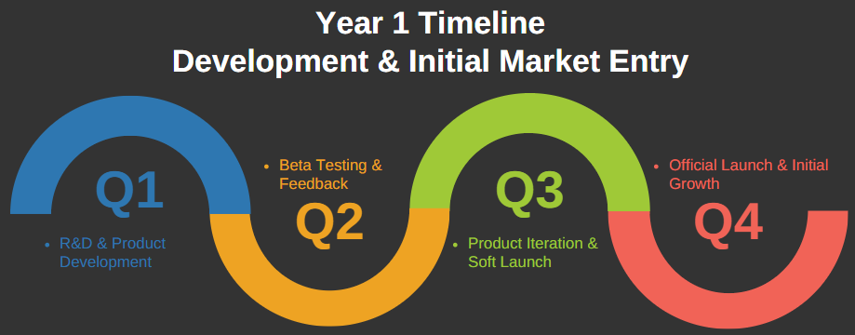
05
Business Plan
Target Market
Co-Working Spaces
Need for efficient scheduling tools amid
flexible workspace growth.
~ USD 88.2m (2023)
Growing at 15% CAGR through 2030
Corporate Offices
High demand for optimized shared
spaces due to hybrid work.
~ USD 58m (2023)
Growing at 10% CAGR through 2030
Educational Institutions
Demand for flexible, multi-user booking systems
for diverse campus needs.
~ USD 37 (2023)
Growing at 18% CAGR through 2030
Timeline

Slide 10
THANK YOU!
Please keep this slide for attribution
Notes:
MONEY
HOW MUCH
2 MILLION FOR 10%

